Slide 1
Practical usage of OpenFAST
Emmanuel Branlard (NREL)
Jason Jonkman (NREL)
NAWEA 2023

Slide 2

About
We provide a shared folder with some Simulations, Demos, Executables, Slides:
[tinyurl will be placed here]
Target audience: [L1]: beginner
[L2]: standard user
[L3]: advanced user
Hopefully this presentation will make some of you level-up!

Slide 3
Outline
Choose your own adventure:
[L2]: Challenges for standard users
[L1]: Become a standard user
When you are on your own (how to find help)
Tools:
pyDatView
python-toolbox (input/output, case generations)
WEIS (DLC generation)
More difficult runs: OLAF, Linearization and Campbell diagrams
Your questions

Slide 4
Tools overview
OpenFAST realm:
Glue codes executables (use multiple modules): openFAST, FAST.farm, TurbSim
Driver executables (use a single module): aerodyn_driver, hydrodyn_driver
Libraries: Simulink, C++ library, DISCON (controller), more and more C-libraries wrapped with python
They take input files and return outputs (files).
ROSCO: opensource controller that can be used with OpenFAST https://github.com/NREL/ROSCO
Python-toolbox: tools for preprocessing and postprocessing OpenFAST files (granular)
https://github.com/OpenFAST/python-toolbox
Matlab-toolbox: tools for preprocessing and postprocessing OpenFAST files https://github.com/OpenFAST/matlab-toolbox
WEIS: tools for preprocessing and postprocessing OpenFAST files (workhorse, e.g. DLC) https://github.com/WISDEM/WEIS
ParaView: for 3D visualization of VTK/VTP files written by OpenFAST https://www.paraview.org/
pyDatView: for 1D visualization of input and output files, some postprocessing https://github.com/ebranlard/pyDatView

Slide 5

1. Chose your own adventure: [L2] Challenges to become a superuser

Slide 6
Challenges for standard users
If you have already used OpenFAST, we don’t want you to be bored during the tutorial... Coming up is a list of challenges that can help you “level up” in your OpenFAST experience.
If you want, send some of your approach/solutions to emmanuel.branlard@nrel.gov, we can then share them to the community.
If you are stuck, we can discuss after the seminar.

Slide 7



Challenges – OpenFAST Debugging
Your friend Luigi wants to go green and change his flag with a wind turbine. To avoid hitting his head with the rotor, he had attached the rotor at a 30 deg yaw angle around the pole (slightly away from his 2D world). He his concerned about the yaw torsion of his flagpole. He has heard of OpenFAST, and he knows tower torsion is not available in ElastoDyn, but he believes he can tune the yaw degree of freedom to approximate the tower torsion of his pole.
He wonders:
What is the natural frequency and damping of the yaw degree of freedom of his structure only, at standstill, without any wind, aerodynamics and rotation
What are these values when the turbine is spinning at a constant speed (9 rpm), with a wind of 8m/s, including aerodynamic forces (but he doesn’t want dynamic stall).
Can he adapt his model to get a structural frequency to 2.5 Hz instead?
He therefore setup an OpenFAST model, with a 30 deg yaw offset to the wind.
But nothing works!
So he calls you, Mario. Can you help him?
See 13_DebuggingChallenge (Make a backup of the folder):
First, try to make the .fst files “runnable”.
Then, look at the outputs of the non-spinning case and investigate.
Redo the step for the spinning case.
Write a script to look at the modal parameters in both cases

Slide 8
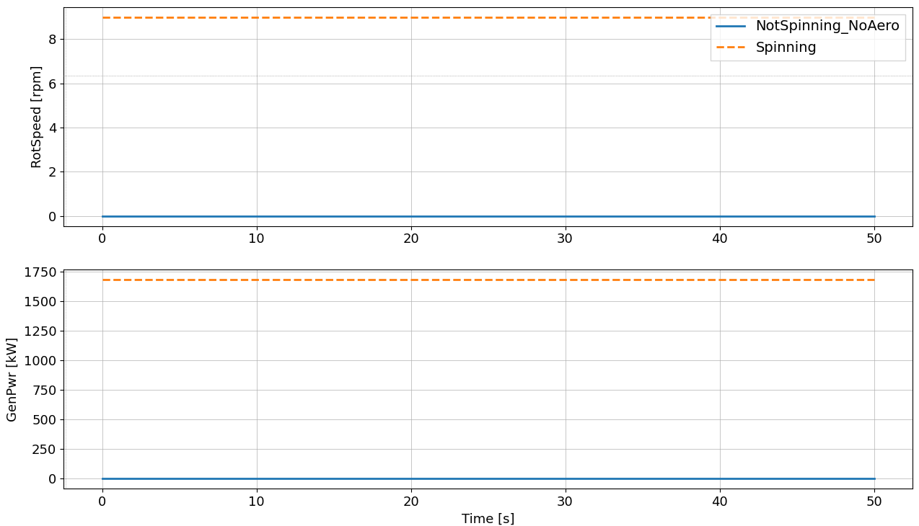
Challenges – OpenFAST Debugging – Expected results
Spinning with aero
Nat. freq. 3.0105[Hz]
Damping ratio 7.8559[%]
Not spinning no aero
Nat. freq. 3.0109 [Hz] Damping ratio 2.0073 [%]

Slide 9
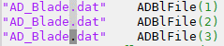
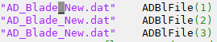
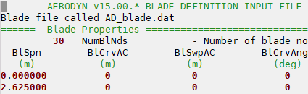
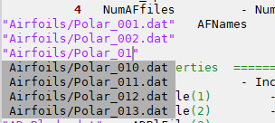
Challenges –Text Editor
NOTE: I can help for Vim
TE1: Setup syntax highlighting so that FAST input files look nicer when you open them. Example specs:
Extensions: .dat, .fst, .dvr, .inp
Comments characters: !, #, ===
Strings: “” or ‘’
Numbers
Keywords: True, False, default (case insensitive)
TE2: Can you edit multiple lines at once?
TE3: Can you open the file where the cursor is located? And then go back.
TE4: Can you open a terminal in the same folder as the file you are editing?
TE5: When you are typing a filepath, can you autocomplete it with existing files on your system?

Slide 10
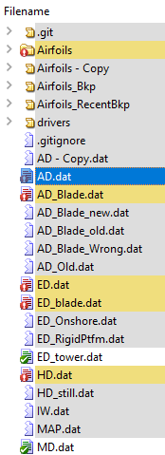
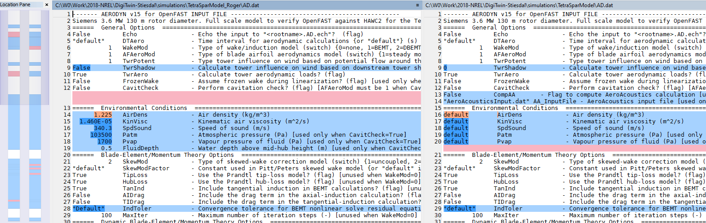
Challenges – Operating system and command prompt
OS1: Can you open a terminal in a given folder from your file explorer? Application: run openfast/turbsim from a given folder
OS2: Can you compare two files? two folders? Application: compare two input files (e.g. different version of conditions)
OS3: Can you copy/paste a filename from the file explorer to your terminal? Application: run openfast/turbsim on a given filename
OS4: Can you add a directory to your system/user path so that binaries within this folder are accessible in your terminal? Application: put your openfast executables in one directory, access them everywhere
OS5: Can you add an alias to your command prompt to shorten commands you often use? Application: alias `python path/to/pydatview` as pydat, or alias `git status` as `lg`

Slide 11
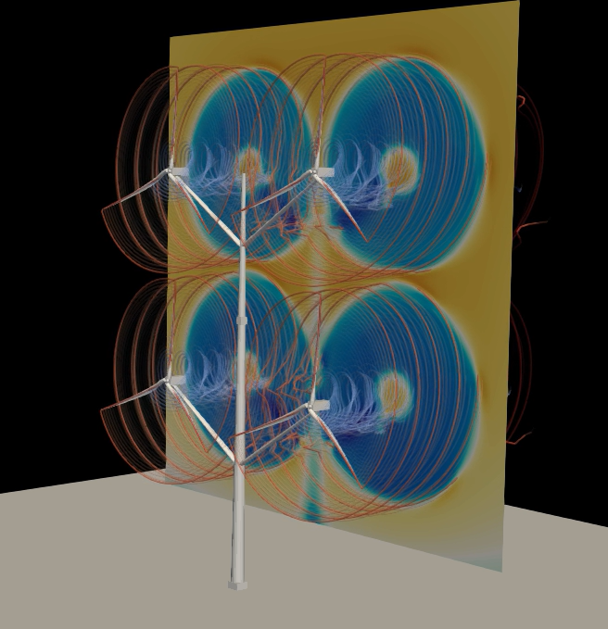
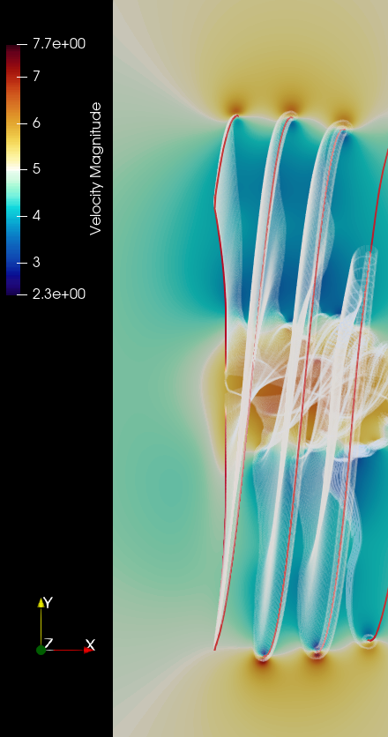
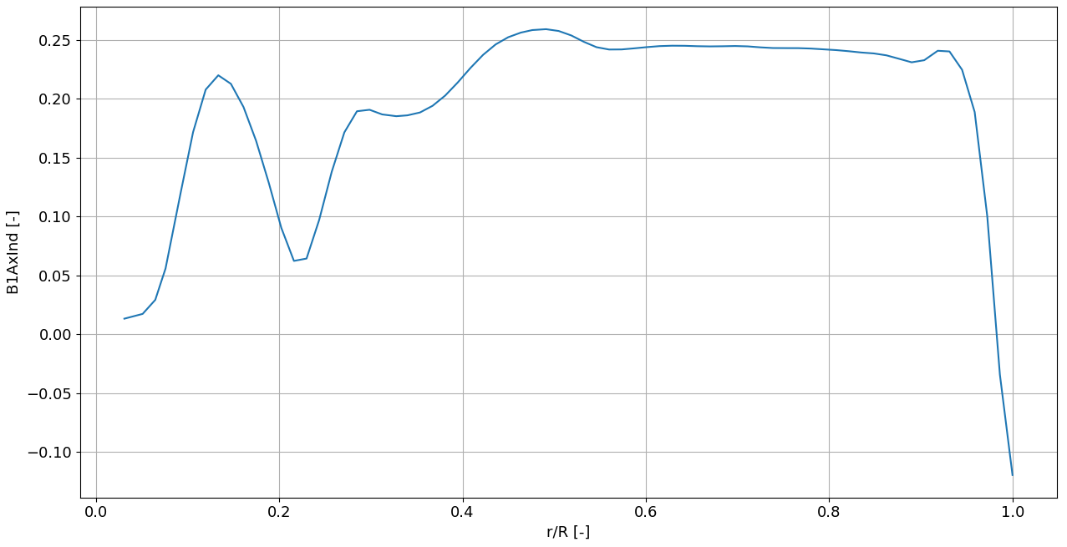
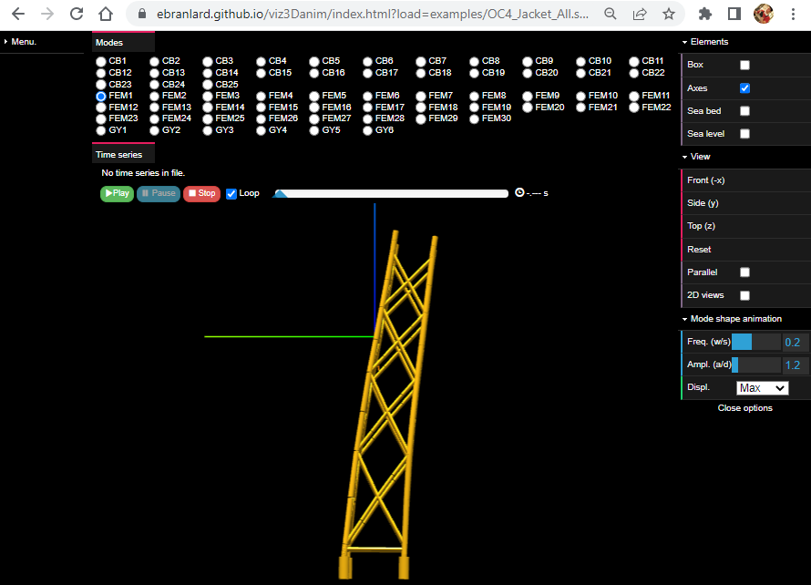
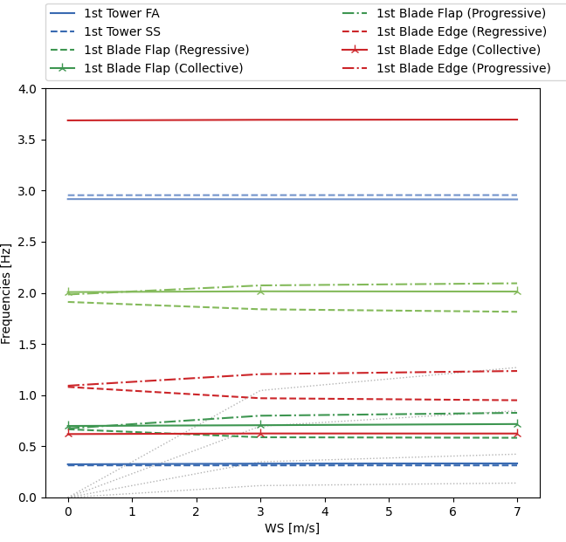
Challenges – OpenFAST Features
OF1: How to 3D-visualize the results of an OpenFAST simulation? Hint: use WrVTK
OF2: How to export velocity and vorticity fields with OLAF? Hint: use the grid outputs of OLAF
OF3: How to export the axial induction for all the nodes of blade 1? Hint: look for BldNd_BladesOut in the documentation. NOTE: you can use pyDatView (FAST Radial average), and/or the python-toolbox examples input_output/examples/Example_RadialPostPro.py to look at the average results.
OF4: How to export and visualize the mode shapes of a substructure in SubDyn? Hint: select JSON export in SubDyn input file and use the webapp viz3danim
OF5: How to run an OpenFAST linearization? Generate a Campbell diagram? Hint: use the option Linearize, and some python-toolbox tools
OF6: Can you prescribe a load time series at the tower top? Hint: Use a nacelle structural controller, see “NumNStC”

Slide 12
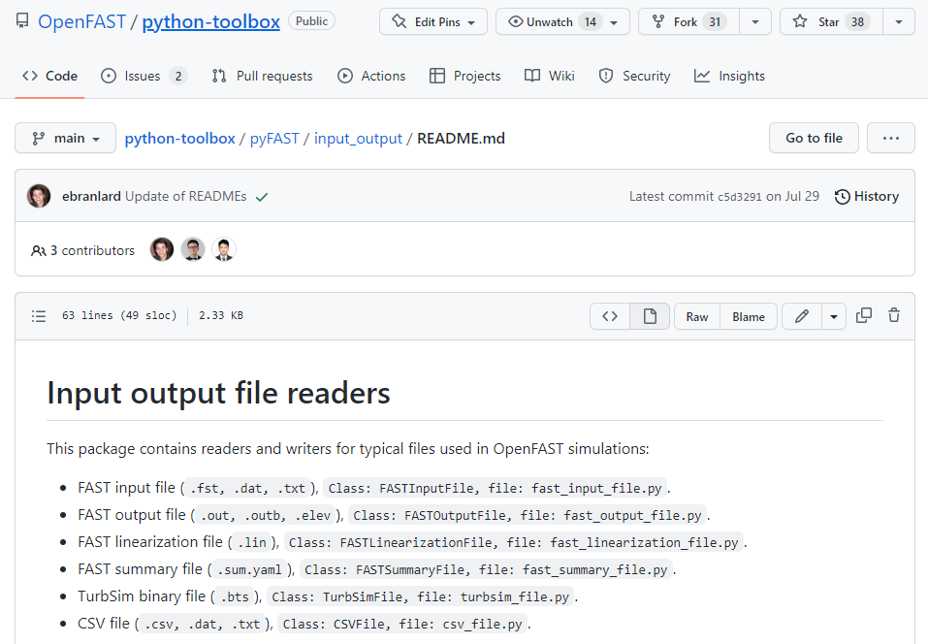
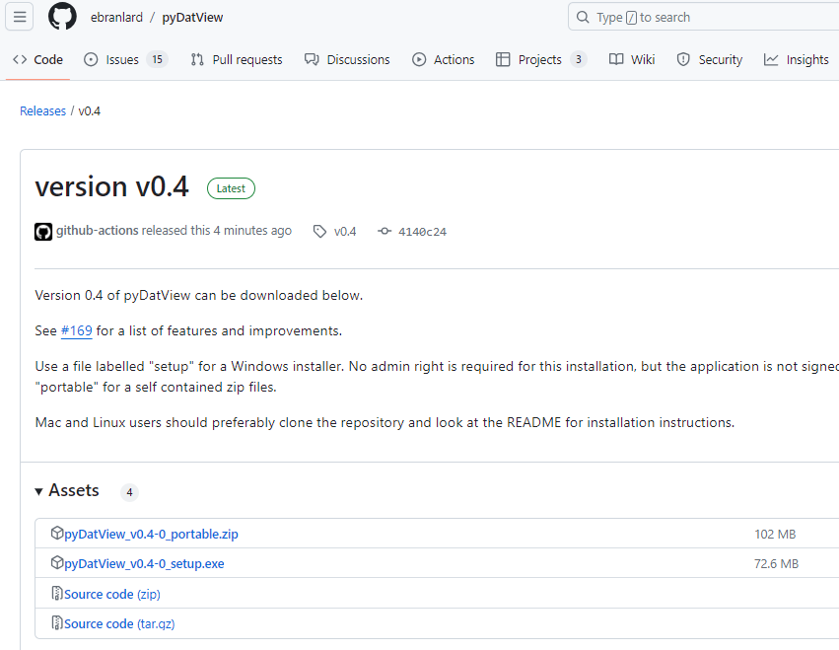
Challenges – Tools
TO1: Can you install the python-toolbox? Have a look at the different examples, try to run them and see if any can be relevant to your work:
input_output/README.md
input_output/examples/*.py
airfoils/examples/*.py
case_generation/examples/*.py
TO2: Can you install pyDatView? (try v0.4 or the latest dev version)
Open several OpenFAST input and output files at once.
Perform some FFT analyses, Compare signals, change the units.
Try the menu “Data/Fast Radial average” on a simulation outputs that has multiple radial outputs (like AB1N001alpha)

Slide 13
Challenges – Developers [L3]
Can you compile the aerodyn_driver, with OpenMP, debug and double precision? Hint: cmake options: -DOPENMP=ON -DDOUBLE_PRECISION=ON -DCMAKE_BUILD_TYPE=Debug
Can you run ctests for the aerodyn_driver only? Hint: cmake options: -DBUILD_TESTING=ON , ctest options: -R ad_BAR*
Can you fork OpenFAST, create an issue, submit a pull request?

Slide 14
1. Chose your own adventure: [L1] Become a standard user

Slide 15
Inputs and outputs
INPUTS:
one main file (extension .fst) which references other files
OUTPUTS:
one data file (.out or .outb) with time series of selected output channels
optional files: summary (.sum), echo (.ech), linearization (.lin), visualization (vtk)
Main.fst
ElastoDyn.dat
Main.out
ED_Tower.dat
Time (s) | Rotor Speed (rpm) | … | Channel[n] (unit)
0 | 5.0
0.1 | 4.9
… | …
tMax | 5.5
ED_Blade.dat
OpenFAST executable
AeroDyn.dat
AD_Blade.dat
Polar.dat
….
Main*.sum
Main*.ech
Main*.lin
vtk*/
…

Slide 16
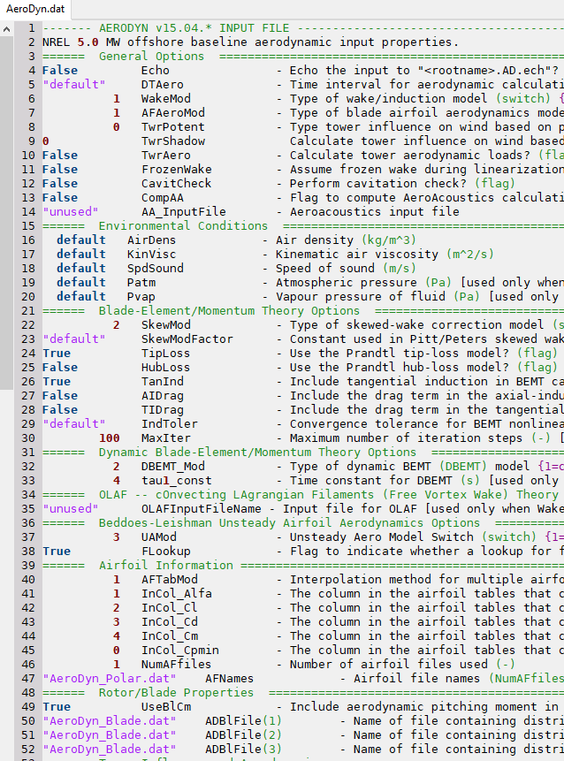
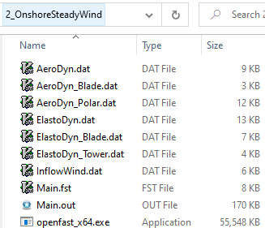
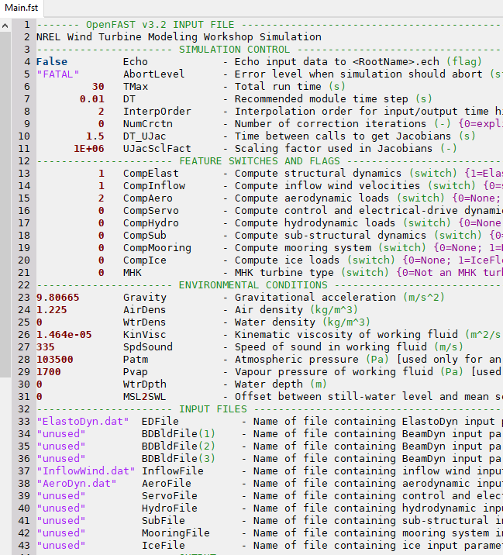
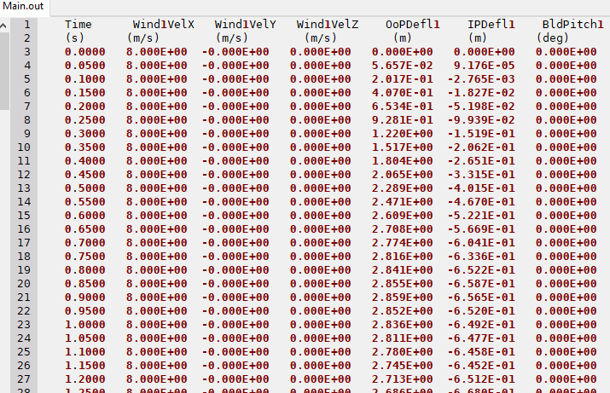
Inputs and outputs (in practice)
Typical folder:
INPUTS
OUTPUT
EXE

Slide 17
Inputs and outputs – Some notes [L1-L2]
Filenames can be absolute (“C:/path/AeroDyn.dat”) or relative (“../AeroDyn.dat”, “./sub/AeroDyn.dat”)
Relative paths are relative to the “parent file” that specify them, for instance: the “main AeroDyn file” is relative to the “Main file (.fst)” the “AeroDyn blade file” is relative to the “main AeroDyn file”
Both “/” and “\” should work, but it’s recommended to use “/”
Avoid filepaths with spaces.. but if you do, remember to surround them by quotes: “my folder/my file.dat”
Output files are overwritten when OpenFAST is rerun!

Slide 18
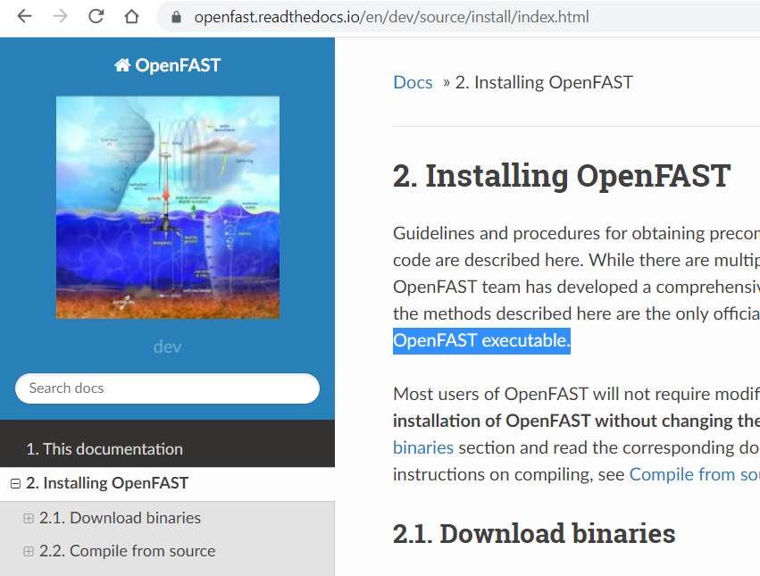
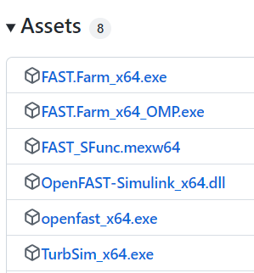
Getting OpenFAST
Installation instructions: https://openfast.readthedocs.io/en/main/source/install/index.html
Windows:
https://github.com/OpenFAST/openfast/releases
(NOTE: the executable are also available from the tinyurl)
Mac/Linux:
# Create a new conda environment
conda create -n openfast_env
# Install OpenFAST through the Conda Forge channel
conda install -c conda-forge openfast
# Test OpenFAST
openfast -v
Compile from source [L3] (possible on all platform) https://openfast.readthedocs.io/en/dev/source/install/index.html#compile-from-source

Slide 19
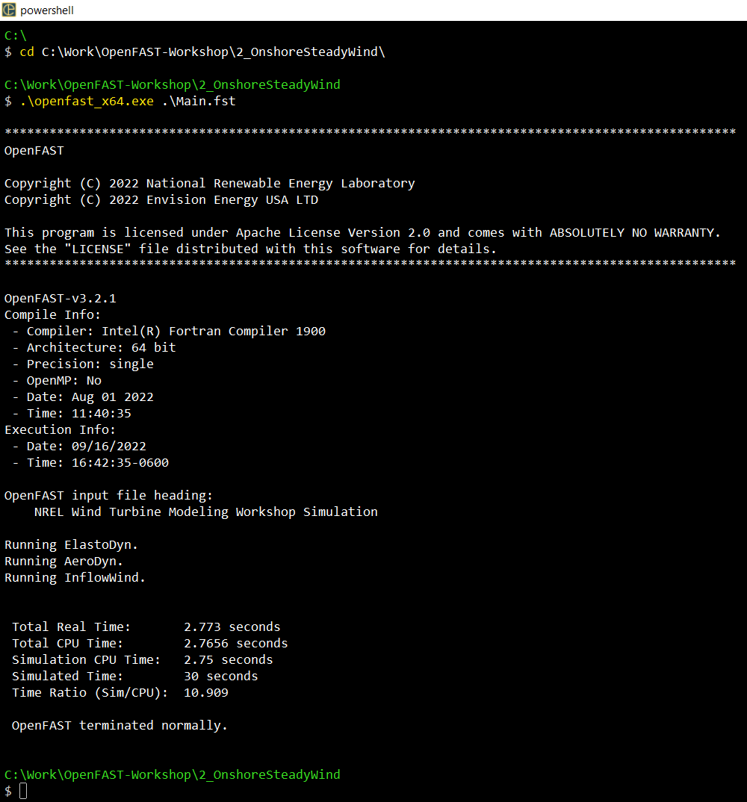
Running OpenFAST
Open a terminal/command line Windows: From the File explorer: File -> Open Windows PowerShell Also, see Challenges OS1 and TE4
Navigate to the folder where the OpenFAST executable and main input file are:
cd path/to/folder
Call the OpenFAST executable with the main input file as argument:
./openfast_x64.exe Main.fst
Pay attention to the terminal outputs
Warnings/errors would show up here

Slide 20
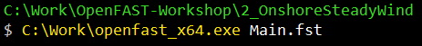
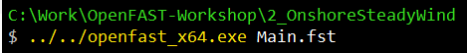
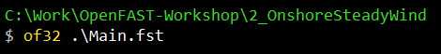
Running OpenFAST – Some notes [L1-L2]
The path to the executable can be absolute or relative to the current folder you are in:
The path of the main input file can be absolute or relative to the current folder you are in:
You can add the directory containing the OpenFAST executable to the system path or create an “alias” in your terminal to avoid having to type the path to the executable all the time
(see Challenges OS4 and OS5)
We recommend running OpenFAST from the directory where the main FST file is located.
Avoid spaces in your filenames and directories
Using the extension of the executable is optional on windows.
The direction of the slashes depends on the OS and terminal (use “\” on windows, use “/” otherwise)

Slide 21
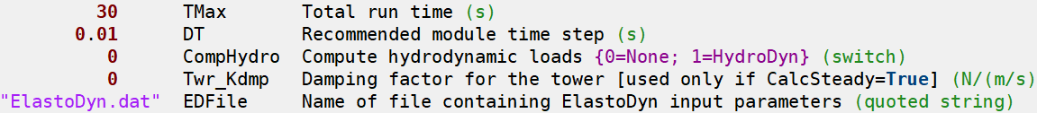

Input file syntax
There are many inputs, which can be overwhelming
It takes time and practice to grasp them all
The syntax is (almost) always the same:
VALUE KEY COMMENT {accepted values} [condition] (unit or type)
Reading the comment is often enough
More details on each input can be found on readthedocs: https://openfast.readthedocs.io/en/ (use the search feature)
All inputs need to be provided and the order matters.
A bit of syntax highlighting makes it more “friendly” (See challenge TE1)

Slide 22
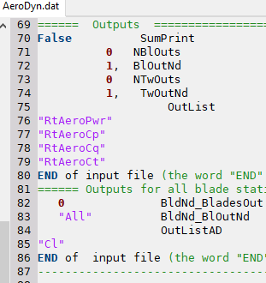
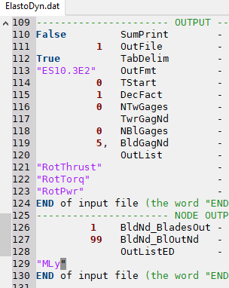
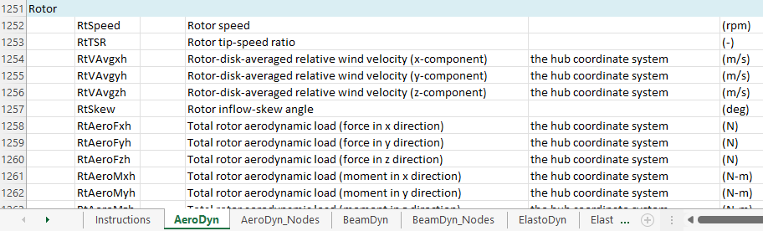
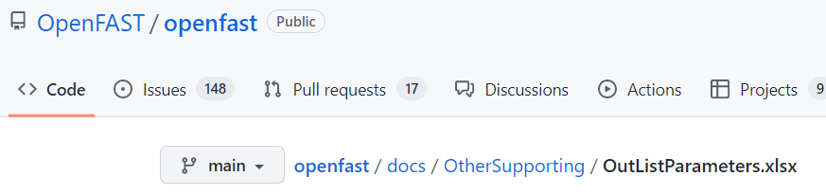
Output file and output channels [L1-L2]
Each module define the output channels at the end of their input file, after the key “OutList”
Output for selected sections is possible via
“Gages” (see e.g. BlOutNd, TwOutNd, TwrGagNd, BldGagNd)
We have recently added “Nodal outputs” for ElastoDyn, AeroDyn and BeamDyn, which provides outputs for all blade sections. (See Challenge OF3 and Case2)
You can find the list of output channels available for each module in the OpenFAST repository: docs/OtherSupporting/OutListParameters.xlsx

Slide 23

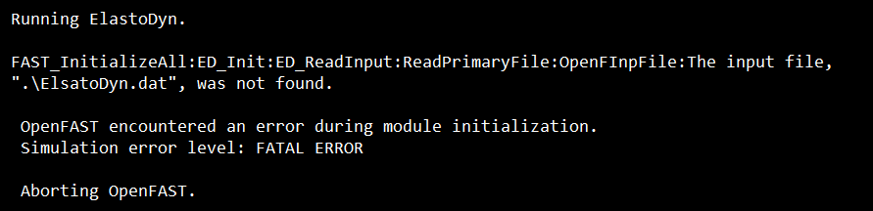
Errors [L1-L2]
User errors are common….
OpenFAST should provide some kind of indication (The terminal output is Function1:Function2:Function[n]:Error Message) Read the error messages carefully
Some hints for common troubleshooting can be found here:
https://ebranlard-openfast.readthedocs.io/en/doc/source/working.html#running-and-troubleshooting-a-simulation
Some general rules:
“Simplify your model to the bare minimum” (for instance: no aerodynamic, stiff structure, steady inflow, no controller)
Make sure your inputs files match the OpenFAST version you are using
Make sure your model is physical

Slide 24
[L1] Quick start/tutorial for new users

Slide 25
Tutorial inputs files
We’ll use cases defined in the folder Simulations from the shared folder
We’ll use the NREL 5-MW (sometimes, a simplified version of it), which is a fictitious but representative multi-MW wind turbine. (https://www.nrel.gov/docs/fy09osti/38060.pdf)
Rated power | 5 MW
Rated rotor speed | 12.1 rpm
Hub Height | 90 m
Rotor diameter | 126 m

Slide 26
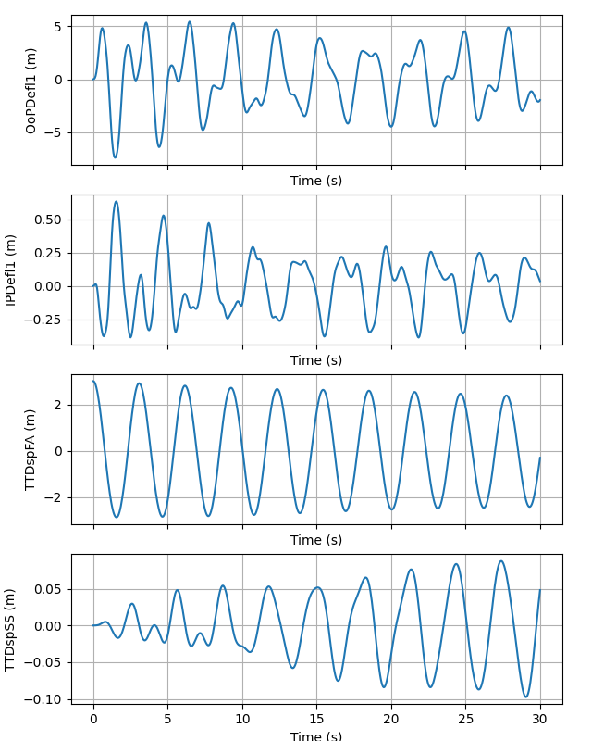
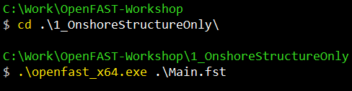
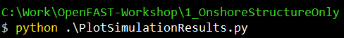
Case 1 – Onshore turbine, structure only
The turbine is only loaded by gravity, the tower is initially displaced by 3m
How to run and plot results (Note: Matlab script provided as well):
Important inputs for this case:
Main.fst: TMax, DT, CompElast, Gravity
ElastoDyn.dat: *DOF*, TTDspFA
Try changing these inputs and rerun
Other files (ElastoDyn_Blade.dat, ElastoDyn_Tower.dat) define the structural properties. They can be plotted with pyDatView or the python-toolbox (Challenge TO1 and TO2)

Slide 27
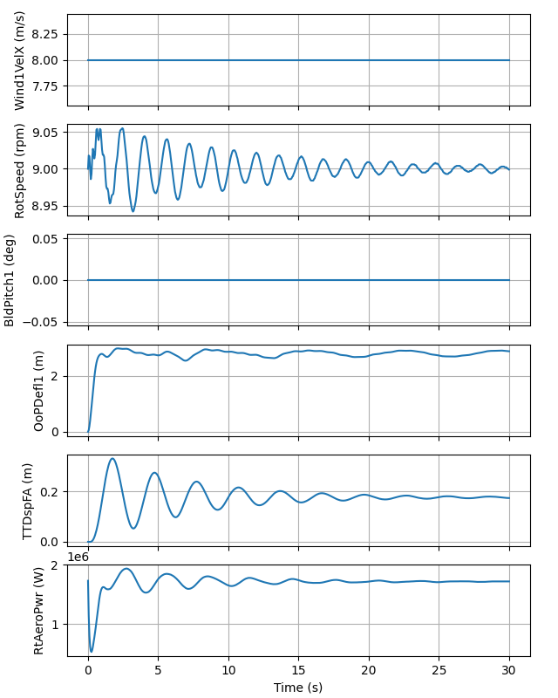
Case 2 – Steady Wind of 8m/s
Aerodynamics loads are now added using the AeroDyn and InflowWind modules
Nodal outputs (AxInd) added to AeroDyn outputs
Important inputs for this case:
Main.fst: CompInflow, CompAero, AirDens
ElastoDyn.dat: RotSpeed, BlPitch*
InflowWind.dat: WindType, HWindSpeed, RefHt, PLExp
AeroDyn.dat: WakeMod, AFAeroMod, TwrPotent
AeroDyn_Blade.dat (blade aerodynamic properties)
AeroDyn_Polar.dat (polar data, here only one polar)
Run OpenFAST on the Main.fst and the plot script
Try changing the wind speed, rotor speed, blade pitch

Slide 28
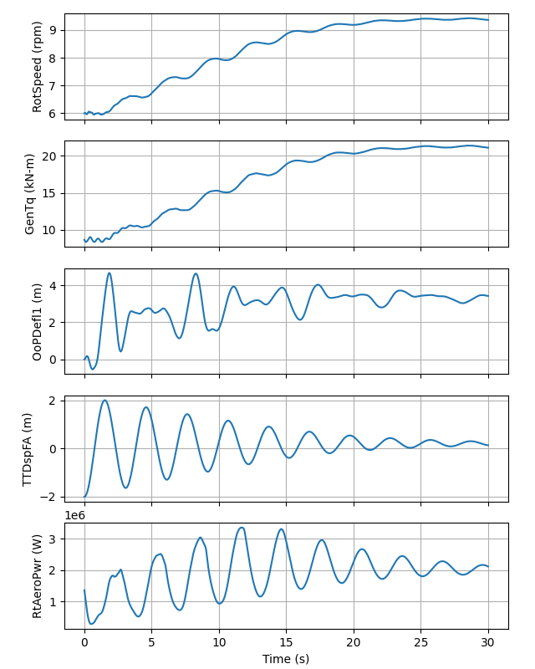
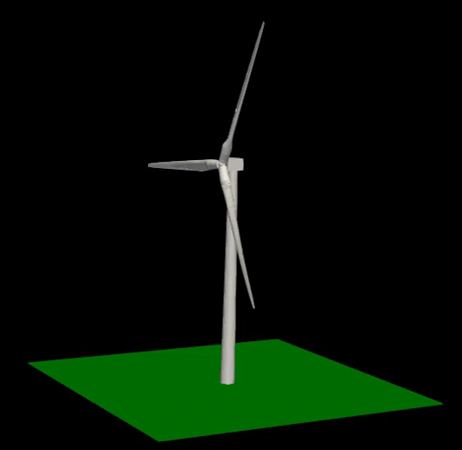
Case 3 – Steady Wind of 8m/s with simple controller
We add a simple controller (generator torque) using the ServoDyn module. (we do not use a DLL to avoid platform compatibility issues)
We refer to input files in the directory ../_5MW_Baseline to avoid repeating common input files
We output 3D surfaces for visualization (see challenge OF1)
The turbine is started with a tower top displacement (to better see the tower motion)
Important inputs for this case:
Main.fst: CompServo , WrVTK, VTK_type, VTK_fps
ServoDyn.dat: VSContrl, VS_Rgn2K, VS_*
Run OpenFAST on the Main.fst and the plot script
Try changing the rotor speed, or the VS_* parameters
Clean your vtk folder if you change fps, tmax, or dt

Slide 29
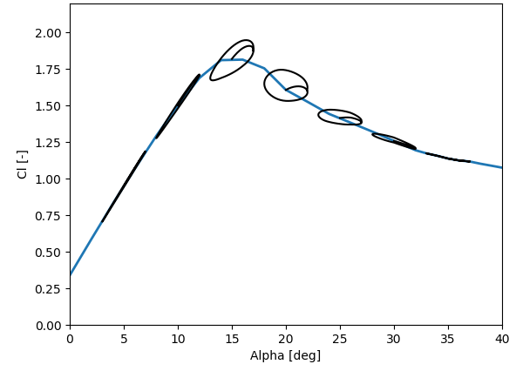
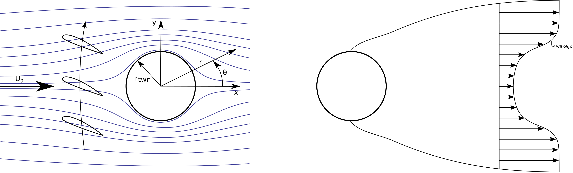
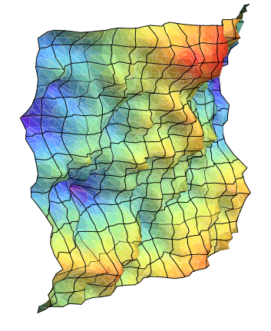
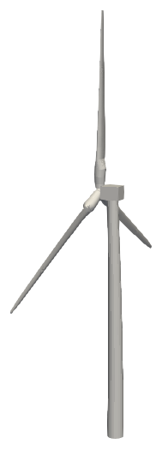
Case 5 – Turbulent Wind ~8m/s with simple controller
In AeroDyn, we add unsteady airfoil aerodynamics (AFAeroMod=2), tower influence (TwrPotent=1), and aerodynamic forces on the tower (TwrAero=True).
We create a turbulent wind field in the TurbSim/AeroDyn format (.bts) using the program TurbSim (part of OpenFAST)
./TurbSim.exe ./TurbSimBox_8mps_5MW.inp
TurbSim executable can be downloaded from: https://github.com/OpenFAST/openfast/releases (latest) https://www.nrel.gov/wind/nwtc/turbsim.html (legacy, v2.0)
It is important that the “box” dimensions are large enough to include the rotor, and, because we use TwrAero, the tower as well (WrADTWR)

Slide 30
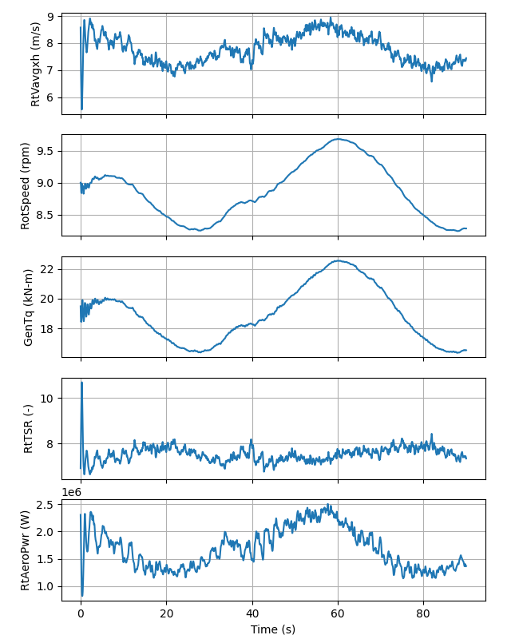
Case 5 – Turbulent Wind ~8m/s with simple controller
Important inputs for this case:
AeroDyn.dat: TwrAero, TwrPotent, AFAeroMod
InflowWind.dat: WindType, FileName_BTS
TurbSimBox*.inp: WrADFF, WrADTWR, NumGrid*, AnalysisTime RefHt, Uref, PLExp TurbModel, IEC*
Run OpenFAST on the Main.fst and the plot script
Try running a longer simulation, changing the mean wind speed of the box, changing the shear (PLExp). Try opening the box in pyDatView.

Slide 31
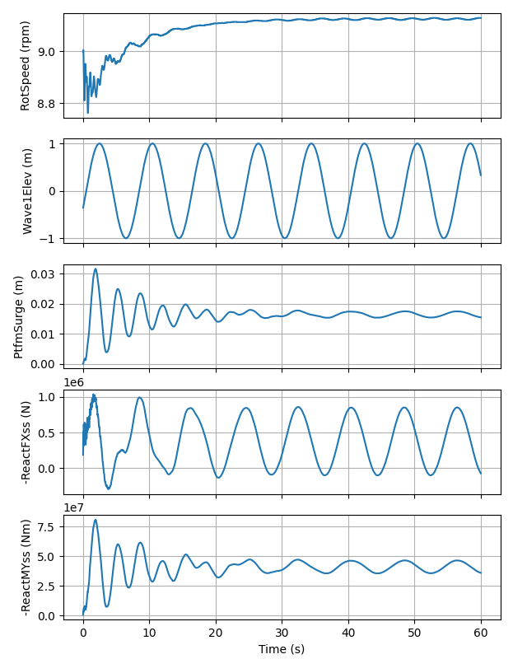
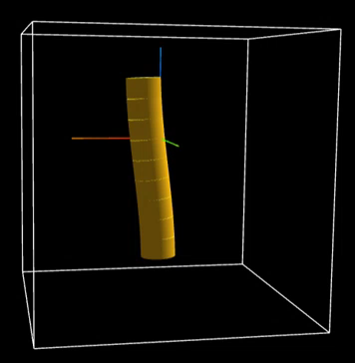
Case 6 – Monopile with regular waves
We use the “offshore“ version of the NREL 5-MW mounted on a monopile (OC3 Monopile developed within IEA Wind Task 23 OC3 project)
The sea state consists of regular waves with 2m height and 8s period
We output the Craig-Bampton modes (see challenge OF4)
Important inputs for this case:
Main.fst: DT, CompHydro, CompSub, WtrDens, WtrDpth
ElastoDyn.dat: Ptfm*DOF, TowerBsHt, PtfmRefzt, PtfmYIner
HydroDyn.dat: WaveMod, WaveHs, WaveTp
SubDyn.dat: Jdampings, Nmodes
Run OpenFAST on the Main.fst. Run the plot script. Open the JSON files in: https://ebranlard.github.io/viz3Danim/
OC3-Monopile Meshes –
HydroDyn (Blue, Green,
Red) & SubDyn (Gray)

Slide 32
3. When you are on your own and need help

Slide 33
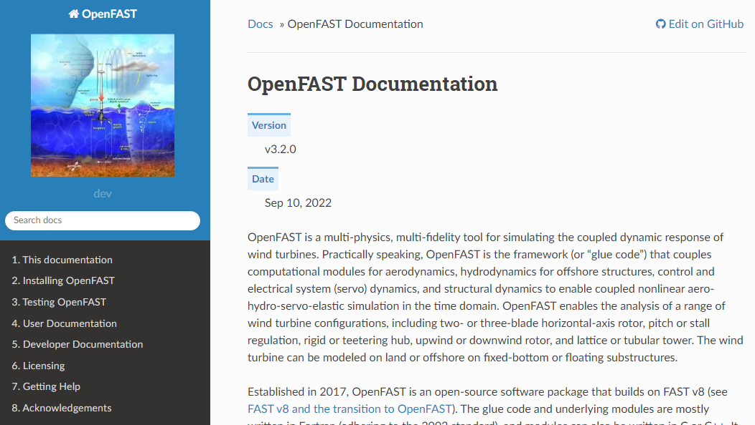
Where to find help
As much as possible, readthedocs:
https://openfast.readthedocs.io/en/
Installing/compiling OpenFAST
User Documentation
Modules input files
Modules theory (AeroAcoustics, OLAF, ExtPtfm, SubDyn, Structural Control, FAST.Farm)
Modules theory not in html (ElastoDyn, ~AeroDyn, HydroDyn, TurbSim)
NOTE: a quick start, with practical usecases, is missing. Hopefully one day! A preliminary version: https://ebranlard-openfast.readthedocs.io/en/doc/source/working.html
NREL forum: https://forums.nrel.gov/
Github issues and discussions:
https://github.com/OpenFAST/openfast/issues
https://github.com/OpenFAST/openfast/discussions

Slide 34
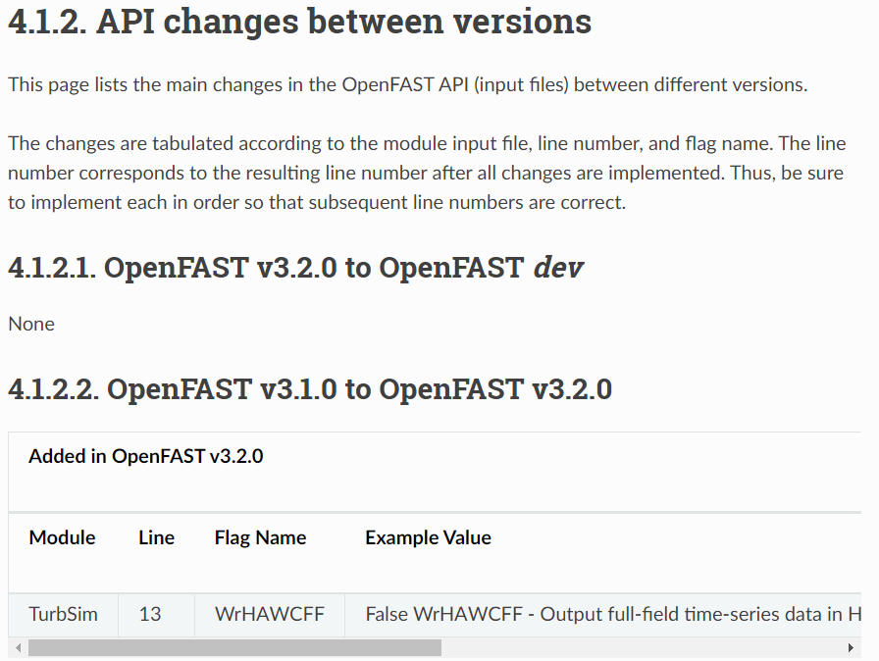
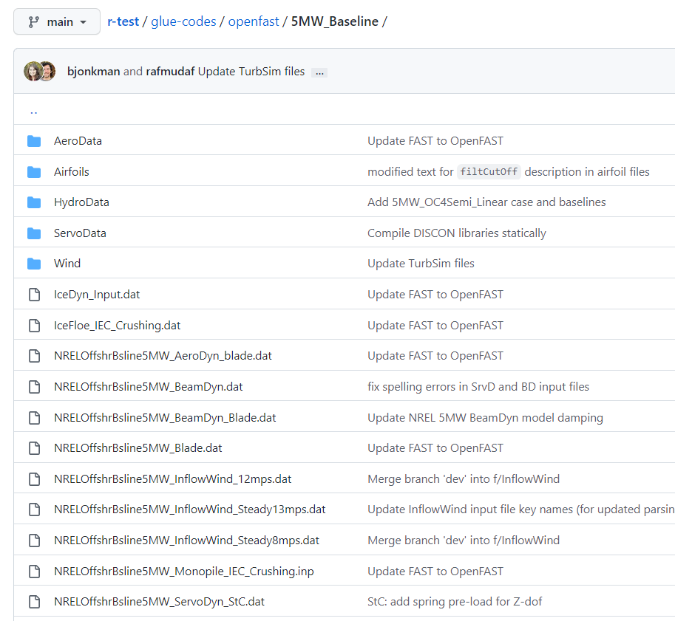
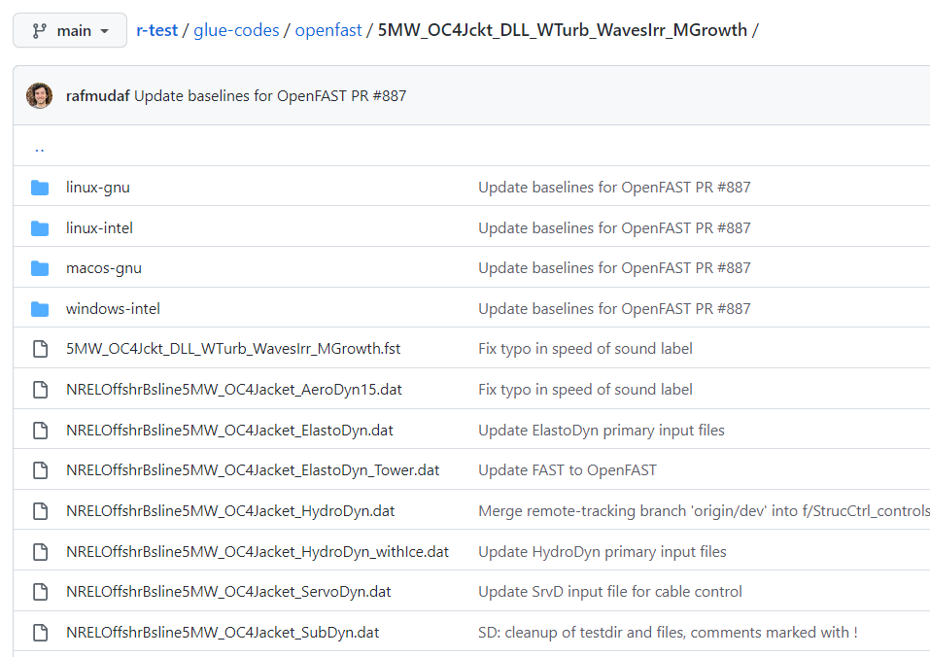
Input files change all the time….
If you change version of OpenFAST the input files will likely change a bit. We are aware that this is painful… it’ll take time for us to improve on that.
[L1] Input file changes from one version to the next are documented here:
https://openfast.readthedocs.io/en/main/source/user/api_change.html
[L1] You can find up-to-date example input files of the current stable version of OpenFAST here: https://github.com/OpenFAST/r-test/tree/main/glue-codes/openfast
Navigate to
5MW_Baseline
or another folder that is similar to what you are trying to simulate:
5MW_OC4Jckt_DLL_WTurb_WavesIrr_Mgrowth (OC4 Jacket, DLL controller, Turbulent wind, irregular waves, marine growth)
Click on a given file to see its format, copy paste content to a new file on your computer, compare with your input file (we’ll cover comparison later)
[L2] If you are using a previous version, clone the repository and checkout the corresponding version tag (and follow similar steps than above)
git clone https://github.com/OpenFAST/r-test/
cd r-test
git checkout tags/v3.2.0

Slide 35
3. Tools to work with OpenFAST

Slide 36
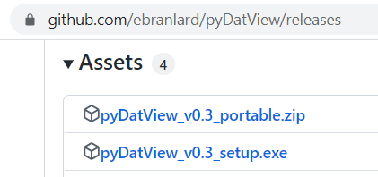
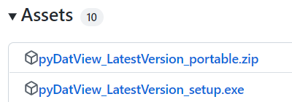
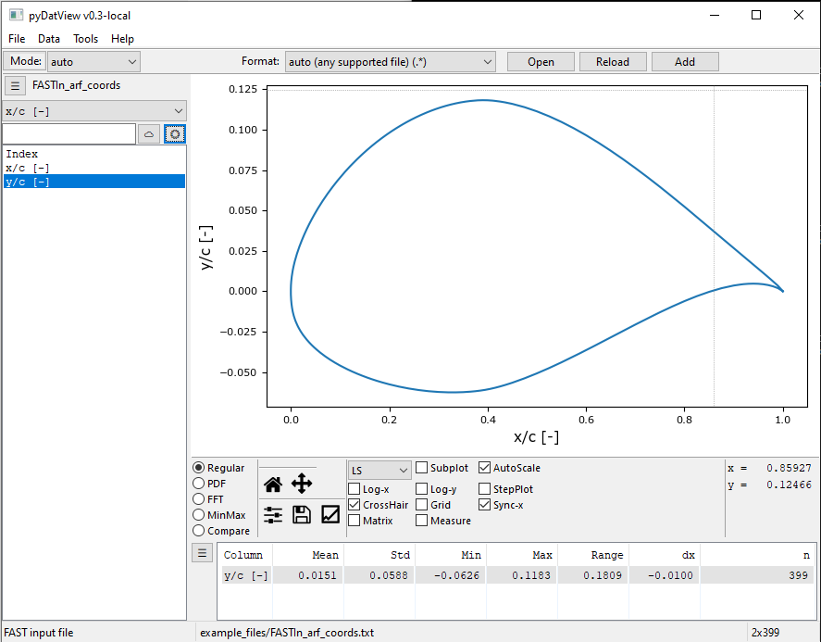
pyDatView
Tool for 1D visualization of input and output files and some typical postprocessing: https://github.com/ebranlard/pyDatView
Windows installation:
Download “setup.exe” files for stable, or latest dev: https://github.com/ebranlard/pyDatView/releases Install it. Then you’ll find pyDatView in the windows menu You can pin it to the task bar and add file association.
Or, clone the repo and install the dependencies
Mac (you might need to stay in the conda base environment):
conda install -c conda-forge wxpython git clone https://github.com/ebranlard/pyDatView -b dev
cd pyDatView
python -m pip install --user -r requirements.txt pythonw pyDatView.py example_files/FASTIn_arf_coords.txt
Linux:
sudo apt-get install libgtk-3-dev # might need to be changed.
# Search for “How to install wxpython on [your OS]” git clone https://github.com/ebranlard/pyDatView -b dev
cd pyDatView
python -m pip install --user -r requirements.txt python pyDatView.py example_files/FASTIn_arf_coords.txt
You can create an alias for quick access (Challenge OS5)

Slide 37


pyDatView
Useful features (see Demos/pyDatview from shared folder):
Open most input and output files
Quickly plots multiple channels
Plot spectra (FFT)
Compare multiple files
Extract FAST(.Farm) radial data
Change units
Perform simple operations on channels
Measure (e.g. periods)
Filter, Resample, Bin, Mask data
Curve Fitting
Export data
Export script
You can also use it directly from python

Slide 38
python-toolbox
Tools to read/write, preprocess and postproces OpenFAST files (granular)
https://github.com/OpenFAST/python-toolbox
As much as possible independent of OpenFAST version
Currently the package is called pyFAST. We might rename it in the future because pyFAST is already taken on pypi.
Installation:
git clone http://github.com/OpenFAST/python-toolbox
cd python-toolbox
python -m pip install -e .
Most of what pyDatView does can be scripted using the python-toolbox (or welib)

Slide 39


python-toolbox – simple examples
(see Demos/python-toolbox from shared folder)
Read an AeroDyn file, modify it and write it back (Example1.py):
from pyFAST.input_output import FASTInputFile
filename = 'AeroDyn.dat'
f = FASTInputFile(filename)
f['TwrAero'] = True
f['AirDens'] = 1.225
f.write('AeroDyn_Changed.dat’)
Read an OpenFAST output file (binary or ascii), plot some signals (Example2.py):
import matplotlib.pyplot as plt
from pyFAST.input_output import FASTOutputFile
df = FASTOutputFile('FASTOutBin.outb').toDataFrame()
print(df.keys())
plt.plot(df['Time_[s]'], df['RotSpeed_[rpm]'])

Slide 40






python-toolbox – simple examples
(see Demos/python-toolbox from shared folder)
Plot the AeroDyn blade properties (Example3.py):
import matplotlib.pyplot as plt
from pyFAST.input_output import FASTInputFile
df = FASTInputFile('data/AeroDyn_Blade.dat').toDataFrame()
plt.plot(df['BlSpn_[m]'], df['BlChord_[m]'])
Read a TurbSim box, modify it, write it back (Example4.py): (Also: fit profiles, plot time series, cross correlation, export to Mann format)
from pyFAST.input_output import TurbSimFile
ts = TurbSimFile('data/TurbSimBox.bts')
print(ts)
ts['u'][0,:,:,:] += 1 # Add 1 m/s in the streamwise direction
ts.write('data/TurbSimBox_Changed.bts')

Slide 41


python-toolbox – simple examples
(see Demos/python-toolbox from shared folder)
Read a CSV file with (alpha, Cl, etc) and write it to AeroDyn format (Example5.py):
from pyFAST.airfoils.Polar import Polar
polar = Polar('data/DU21_A17.csv', fformat='delimited')
ADpol = polar.toAeroDyn('data/AeroDyn_Polar_DU21_A17.dat’)
Read an output file and average the radial/nodal data (Example6.py):
import matplotlib.pyplot as plt
import pyFAST.input_output as io
import pyFAST.input_output.postpro as postpro
# Step 1: Read an openfast output file
df = io.fast_output_file.FASTOutputFile('data/Main.out').toDataFrame()
# Step2 : Average data (over 1 period) and extract the radial stations
dfRad_ED, dfRad_AD, dfRad_BD = postpro.spanwisePostPro( FST_In='data/Main.fst', avgMethod='periods', avgParam=1, df=df)
# Plot
plt.plot(dfRad_AD['r/R_[-]'], dfRad_AD['B1AxInd_[-]'])

Slide 42


python-toolbox – simple examples
Create input files for parametric simulations (Example7.py):
import pyFAST.case_generation.case_gen as case_gen
import pyFAST.case_generation.runner as runner
import pyFAST.input_output.postpro as postpro
ref_dir = 'templateDir/' # Folder where the fast input files are located (will be copied)
main_file = 'Main.fst' # Main file in ref_dir, used as a template
work_dir = 'parametric/' # Output folder (will be created)
# Define the parametric study (list of dictionaries)
PARAMS=[] for i, (wsp, rpm) in enumerate(zip([4,5,..], [2,7,..])): p = {'TMax': 10}
p['EDFile|RotSpeed'] = rpm
p['InflowFile|HWindSpeed'] = wsp
p['__name__'] = 'case_'+str(i+1) # basename for all files
PARAMS.append(p)
# Generate all files in a working directory
fastFiles = case_gen.templateReplace(PARAMS, ref_dir, outputDir=work_dir, main_file=main_file)
# Run the simulations
runner.run_fastfiles(fastFiles, fastExe='./openfast_x64.exe’, nCores=2)
# Simple postprocessing (mean value of all channels over the last period for each simulation)
outFiles = [os.path.splitext(f)[0]+'.out' for f in fastFiles]
avg_results = postpro.averagePostPro(outFiles, avgMethod='periods’, avgParam=1) plt.plot(avg_results['WS_[m/s]'], avg_results['RtAeroCp_[-]'])

Slide 43
python-toolbox
Find more examples on the repository (look for “examples” folder in each subdirectory).
https://github.com/OpenFAST/python-toolbox/

Slide 44
WEIS - ROSCO
WEIS: Documentation and examples: https://github.com/WISDEM/WEIS
WEIS wraps both OpenFAST and python tools together
Everything is compiled during installation.
WEIS is useful to run optimization studies, parametric studies, full DLC load cases, with batch postprocessing, including rainflow counting.
You will likely still need the python-toolbox for “granularity” (simple tasks)
ROSCO (controller): Documentation and examples: https://github.com/NREL/ROSCO
Compile a controller (using cmake)
Tune a controller for a given turbine
See different examples in the repository

Slide 45
4. More difficult runs: OLAF, Linearization

Slide 46

OLAF – Guidelines
We always have to setup and adapt the OLAF parameters. The guidelines of the documentation are a good start: https://openfast.readthedocs.io/en/dev/source/user/aerodyn-olaf/RunningOLAF.html#guidelines
Two main concerns:
“Meshing” (wake length and time step)
“Regularization” (vortex code / avoiding singularity)
You need to setup the “meshing” for different:
rotational speed
mean wind speed
(average axial induction)
(rotor size)
Because
we want a sufficiently long wake
the wake is expressed in terms of “number of panels”
we don’t want the simulation time to be too large
You need to tune the regularization parameters because:
It is not an exact science, and it depends on the rotor scale
Visual inspection of the wake and velocity field helps.
Note: simulations will be faster if compiled with OpenMP

Slide 47
OLAF – Case 9
(See Simulations/9_RigidSteadyWind_OLAF in shared folder)
We compare BEM and OLAF. OLAF parameters are not tuned in this example!
To setup the OLAF parameters we provide a script: Params.py
Important inputs for this case (in OLAF.dat):
nNWPanels, nNWPanelsFree
WakeRegFactor, WingRegFactor
The OLAF simulation generates VTK files in the folder vtk_fvw (see OLAF inputs WrVTK and GridOuts)
The postprocessing script (PlotSimulationResults.*) compares BEM/OLAF and shows the velocity field at the end of the simulation

Slide 48






OLAF – Case 9
Before parameter setup: (wake way too short, spiky velocity field)
After parameter setup:
Note: we still need to run longer, convergence has not been reached. The guidelines estimate the transient time to be 186s

Slide 49



Linearization – Some preliminary notes
Warning: The process can be tedious and time consuming ([L3], but we’ll try step by step…)
Simplified theory: Given a nonlinear state equation: We can linearize it about an operating point using a Taylor expansion: An eigenvalue analysis of A gives: frequencies, dampings, modes of the system
Implementation:
OpenFAST performs similar operations than this simplified theory behind the scene, with added complexity due to the modular framework, and the account of algebraic constraints, see Jonkman et al. 2016, 2018.
The “same code” is run within OpenFAST during time-domain simulations and during linearization
OpenFAST mostly use finite differences to compute Jacobian
A subset of the modelling options is available when doing linearization (for instance in AeroDyn we need FrozenWake=True, WakeMod=1, AFAeroMod=1, in ServoDyn we need the simple VS controller)
A

Slide 50


Linearization – Some preliminary notes
Rotating system:
When the system is rotating, the operating point is a periodic steady state.
We need to linearize multiple times across one revolution.
Due to the presence of states in the rotating frame, a multi-blade coordinate transform needs to be applied to the “A” matrices before averaging them over one revolution.
In practice:
Linearization is activated using the Linearize input file switch
It’s the user responsibility to ensure the operating point is an equilibrium point.
A trimming algorithm is available to help this process.
Let’s see with examples…
“Linfile (.lin)”

Slide 51




Linearization – Case 10 – Blade Only in Vacuum
(See Simulations/10_Linearization_BladeOnly_Vacuum in shared folder)
Only one blade, only the Blade DOFs are on
Vacuum conditions: gravity is zero, no aero/inflow
Linearization is requested at t=0.
A “lin-file” (extension.lin) is generated.
Important inputs for this case:
Main.fst: Linearize, NLinTimes, LinTimes, Gravity
ElastoDyn.dat: *DOF*, NumBlades
The postprocessing script (postpro_SimpleEigenAnalysis.*) performs a simple eigenvalue analysis on the A matrix:
Nat. freq. [Hz] Damping ratio [%] Mode Identified
0.6717 0.4738 1st Flap
1.0791 0.4712 1st Edge
1.9809 0.4894 2nd Flap

Slide 52

Linearization – Case 11 – Rotating
(See Simulations/11_Linearization_Rotating in shared folder)
Three blades, Blade DOFs on and generator DOF on (others are off)
Wind Speed=8m/s, Target rotational speed of 9 rpm.
Linearization is obtained using a “Trim” algorithm (CalcSteady), which ensures that the rotational speed is as specified. The trim algorithm continuously adapts the generator torque or pitch angle (depending on TrimCase), and waits for a (periodic) equilibrium to be reached.
36 “lin-files” are generated over one rotor revolution (based on input NLinTimes)
Important inputs for this case:
Main.fst: Linearize, CalcSteady, TrimGain, TrimCase, NLinTimes
AeroDyn.dat: FrozenWake=True, WakeMod=1, AFAeroMod=1 (needed for linearization)
ElastoDyn.dat: RotSpeed
The postprocessing script (postpro_OneOP.*) performs a multi-blade coordinate (MBC) transformation on all the A matrices (found in each lin-file) before averaging them
#, NatFreq_[Hz], DampRatio_[-], Mode_Identified[-]
1, 0.588, 0.632 , ED 1st flapwise cos 2, 0.722, 0.526 , ED 1st flapwise coll.
3, 0.841, 0.441 , ED 1st edgewise sin
4, 0.937, 0.016 , ED 1st edgewise cos
5, 1.237, 0.012 , ED 2nd flapwise sin
6, 1.837, 0.155 , ED 2nd flapwise sin
7, 1.987, 0.142 , ED 2nd flapwise coll.
8, 2.133, 0.133 , ED 1st flapwise cos
9, 2.256, 0.022 , ED Variable speed generator DOF

Slide 53

Linearization – Case 11 – Rotating
(See Simulations/11_Linearization_Rotating in shared folder)
You can also try the script (postpro_MultiLin_Campbell.py) which is intended for several Operating points (OP)
#, NatFreq_[Hz], DampRatio_[-], Mode_Identified[-]
1, 0.588, 0.632 , ED 1st flapwise cos 2, 0.722, 0.526 , ED 1st flapwise coll.
3, 0.841, 0.441 , ED 1st edgewise sin
4, 0.937, 0.016 , ED 1st edgewise cos
5, 1.237, 0.012 , ED 2nd flapwise sin
6, 1.837, 0.155 , ED 2nd flapwise sin
7, 1.987, 0.142 , ED 2nd flapwise coll.
8, 2.133, 0.133 , ED 1st flapwise cos
9, 2.256, 0.022 , ED Variable speed generator DOF

Slide 54



Linearization – Case 12 – Campbell diagram
(See Simulations/12_Campbell in shared folder)
All degrees of freedom are ON, except generator (to avoid switching between TrimGain=2 and TrimGain=3)
The operating conditions are specified in a CSV file (rotor speed, wind speed, pitch)
The script runCampbel_NoServo.*:
Generates input files for each operating conditions
Runs OpenFAST (the trim algorithm is used to find a periodic steady state)
Postprocess the linfiles, generates a set of Campbell files “Campbell_*.*”, and plots them

Slide 55


Linearization – Case 11 – Campbell diagram
In this case, the identification works fine
Usually, the user needs to adjust the Mode ID file: “Campbell_ModesID.csv” file
You can try plotting the Campbell diagram using a different ID file: python .\plotCampbellData.py .\Campbell_NoServo\Campbell_ModesID_WrongID.csv WS
You can also rerun the script runCampbell*.py setting: writeFSTfiles = False, runFast=False, and changing the variable modeID_file

Slide 56


Linearization – Some more notes
Mode Identification is usually difficult and time consuming
When the Generator DOF is ON (Using the simplified controller), depending on the wind speed, the user needs to switch between:
TrimGain=2 in Region2 (Generator Torque control)
TrimCase=3 in Region 3 (Pitch control)
At the boundary between the two, things can be tricky. A good hack is, in Region 3, to set the rated speed to a small value so that Qgen=Qrated, for instance VS_RtGnSp = 0.01
The python function writeLinearizationFiles (pyFAST), should take care of all of that (remember to set trimGainPitch, trimGainGenTorque, and possibly maxTrq). The Operating point file needs to contain the Generator Torque so that the function can decide when to switch from region 2 and 3.
It can happen that the trim algorithm does not find a periodic steady state (even after a long time like 5400s). The latest OpenFAST will output one lin time at the end of the simulation.
3D visualization of mode shapes is possible, but even more tedious. You can read about it here: https://ebranlard-openfast.readthedocs.io/en/doc/source/working.html
We will work in the coming two years at improving the process.

Slide 57
Good luck in your OpenFAST journey

Slide 58
5. Your questions

